Slide 1
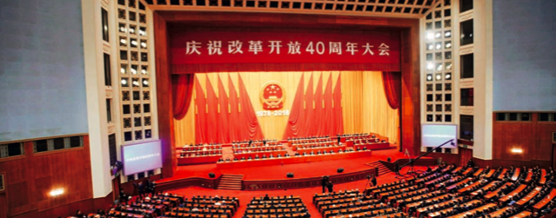
The Reform and Opening Up
Tuesday 12/08/2020
Presented by: 张薇
China holds a grand gathering to celebrate the 40th anniversary of the country’s reform and opening up at the Great Hall of the People in Beijing on December 18,2018.

Slide 2
Table of Contents
01
04
02
05
03
Rural Reform
Welcome!
Household Responsibility system
Here you could describe
SOEs Reform
Events
SOE reform
Here you could describe
Opening Up
Special Economic Zones

Slide 3
The 3rd Plenary Session of the 11th Central Committee of the Chinese Communist Party
1978.12.18-12.22
During the session, important decisions were made on such issues as economic adjustment, economic governance reform, promoting agricultural development and improving the people’s wellbeing.
Deng Xiaoping (chief architect) called on Party members to emancipate themselves from ideological straitjackets, seek truth from facts, and forge ahead in unity. (解放思想、实事求是、团结一致向前看)
Its significance: marking
an end to the lengthy dominance of leftist dogmatism (“左”倾错误) that placed China in shackles of blind adherence to the “Two Whatevers” (“两个凡是”)
a shift of focus from class struggle to economic development
the beginning of the “Reform and Opening Up” policy
Reform: from a centrally planned economy to a dynamic socialist market economy
Opening up: from a closed or semi-closed society to an open one.
(Keywords.China.org.cn (中国关键词), run by China International Publishing Group (中国外文局), China Academy of Translation (中国翻译研究院), and Translators Association of China (中国翻译协会), 2018)

Slide 4
Rural Reform
Woeful situation under the People’s Commune Campaign (人民公社化运动) and the Great Leap Forward (大跃进).
Practices of “Contracting output quotas to household” (包产到户) met with pressure from the central
A secret agreement among peasants of Xiaogang Village, Fengyang County, Anhui Province.
Deng Xiaoping, “It does not matter if it is a black cat or a white cat, as long as it catches mice”
Two documents giving official basis for the previous private practices
1980.9 – “Some Issues Regarding Further Strengthening and Improving the Responsibility System for Agriculture Production” (《进一步加强和完善农业生产责任制的几个问题》)
1982.1.1 – “No. 1 document” on Rural economic policies (中央一号文件《全国农村工作会议纪要》)
(Under the guidance of these two documents, the “contracting output quotas to household” quickly spread) By the end of 1982, all communes were gone.
The “contracting responsibilities to households” became the mainstream of what we now call, the Household Responsibility System (家庭联产承包责任制), signifying the completion of the transition of China’s agricultural operating system from the collective economic system of people’s communes to the system of family farms established by peasants on the “contracted” plot.
(Wu Jinglian (吴敬琏), Understanding and Interpreting Chinese Economic Reform (《当代中国经济改革教程》) )

Slide 5
Rural Reform
 |  | 1978 | 2000 | 2018 | 2019
农林牧渔业总产值（亿元） Gross Output Value of Agriculture, Forestry, Animal Husbandry and Fishery |  | 1397 | 24915.8 | 113579.5 | 123967.9
主要农产品产量（万吨） Output of Major Farm Products | 谷物 Cereals |  | 40522.4 | 61003.6 | 61369.7
 | 棉花 Cotton | 216.7 | 441.7 | 610.3 | 588.9
 | 油料 Oil-bearing Crops | 521.8 | 2954.8 | 3433.4 | 3493
 | 肉类 Meat |  | 6013.9 | 8624.6 | 7758.8
 | 水产品 Aquatic Products | 465.4 | 3706.2 | 6457.7 | 6480.4
(China Statistical Yearbook 2020 《中国统计年鉴2020》)

Slide 6
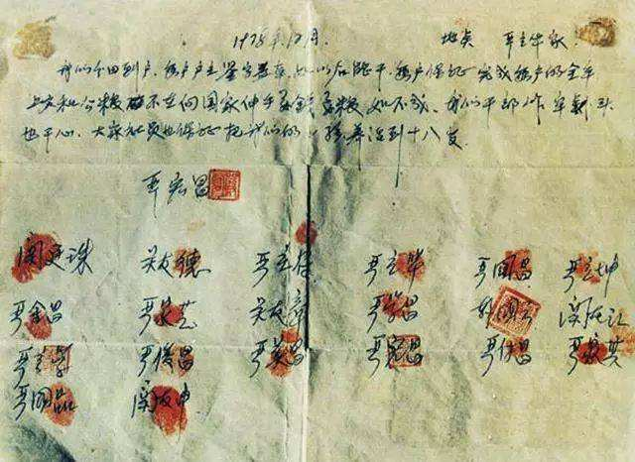
The agreement signed in 1978

Slide 7
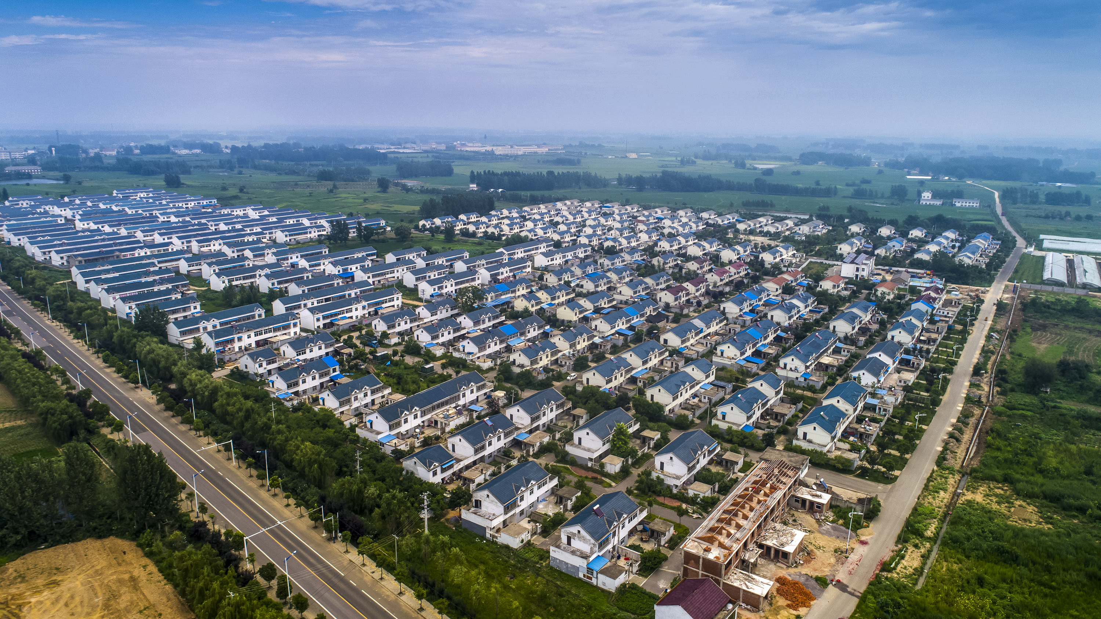
Xiaogang Village in 2017

Slide 8
SOEs Reform
1978-1993 放权让利
1993 : 14th CCCPC
现代企业制度
1997：15th NCCPC 抓大放小
2003 SASAC
Power devolution: Transferring part of the control from the government to enterprises
a modern corporate structure featuring “clearly established ownership, well-defined power and responsibility, separation of government administration and enterprise management, and scientific management.”
产权清晰、权责明确、
政企分开、管理科学
strategic reorganization of SOEs by managing large enterprises well and relaxing control over small one
creation of the State-Owned Assets Supervision and Administration Commission
国家资产监督管理委员会

Slide 9
From Planned Economy to Socialist Market Economy
The right of contracted land use (土地承包经营权)
Privatization of SOEs
1992 - 14th CPC National Congress (党的十四大) affirmed the objective of China’s economic reform was to build a socialist market economy.
1993 - 14th CPC Central Committee at its 3rd plenary session (党的十四届三中全会)
highlighting the role of the market in resource allocation
(Keywords.China.org.cn)

Slide 10
Opening Up
Foreign Trade Policy
The government adopted the export-oriented strategy, supporting export industry and establishing export producing system.
The government encouraged companies to absorb foreign direct investment (外商直接投资FDI).
Special economic zones 经济特区
Open coastal cities沿海开放城市
Special economic development zones 沿海经济开放区
1980 Shenzhen, Zhuhai, Xiamen and Shantou
1988 Hainan
2010 Khorgas and Kashi in Xinjiang 霍尔果斯和喀什
1990 the development and opening up of Pudong District of Shanghai
(Keywords.China.org.cn)

Slide 11
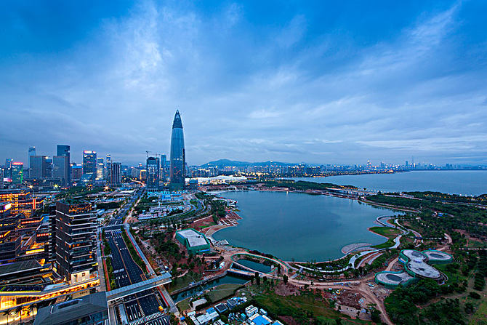
Shenzhen

Slide 12
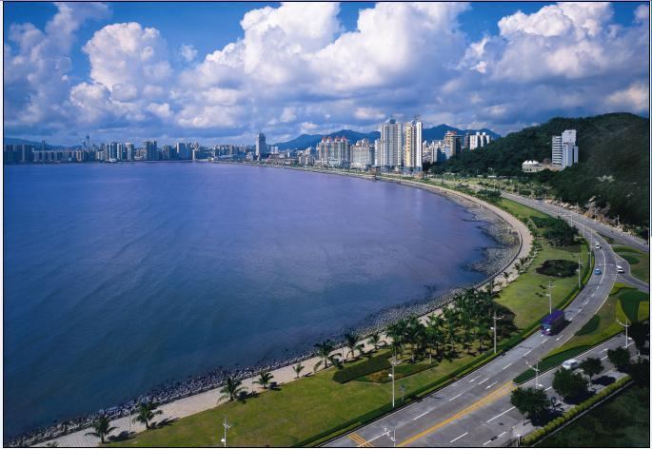
Zhuhai

Slide 13
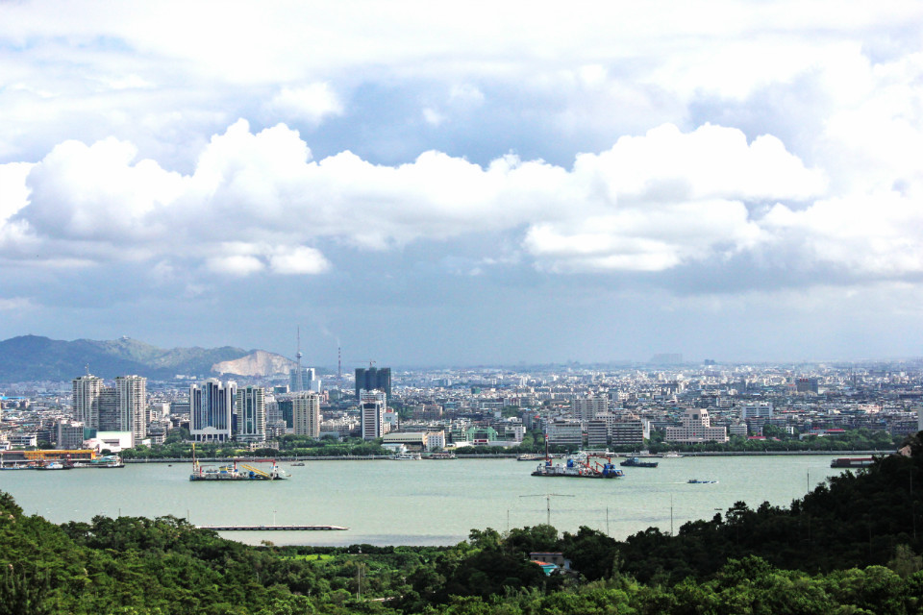
Shantou

Slide 14

Xiamen

Slide 15
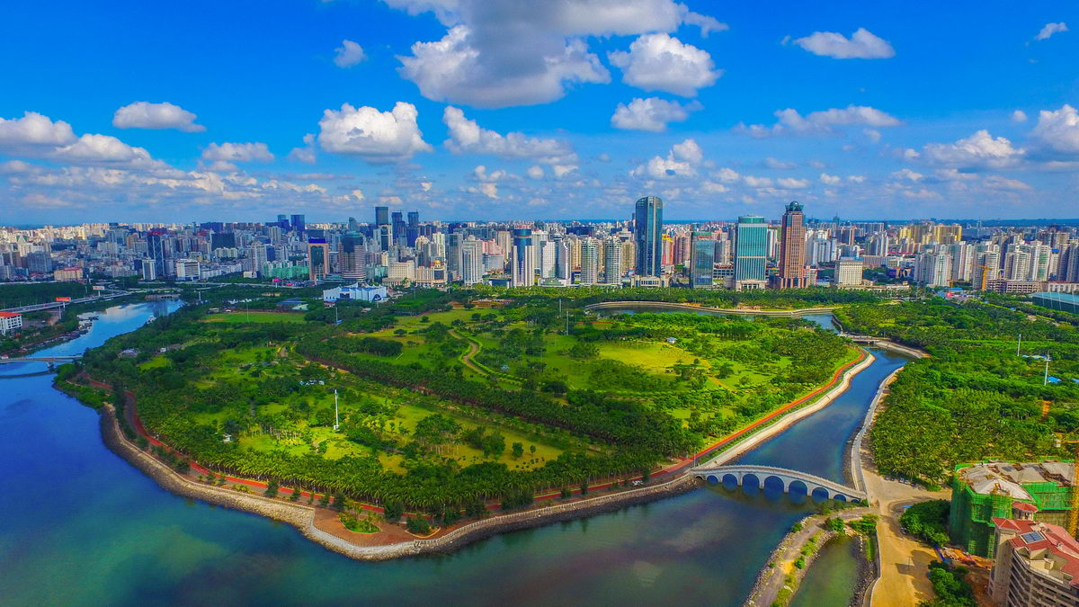
Hainan

Slide 16
References
Presented by: 张薇
Tuesday 12/08/2020
China.org.cn. (2018) “The Third Plenary Session of the 11th CPC Central Committee.” <http://www.china.org.cn/english/china_key_words/2018-10/29/content_68859250.htm>
China Statistical Yearbook 2020 (《中国统计年鉴2020》). <http://www.stats.gov.cn/tjsj/ndsj/2020/indexeh.htm>
白远 《当代中国经济改革与发展》
Wu Jinglian. Understanding and Interpreting Chinese Economic Reform.

